Slide 1
Integration of REST Assured with TestNG
This framework consists of:-
REST Assured – 4.3.3
Java 8 or above
TestNG – 7.4.0
Maven – 3.8.1
Steps to setup Rest API Test Automation Framework with REST Assured and TestNG
Download and Install Java on system
Download and setup Eclipse IDE on system
Setup Maven
Create a new Maven Project
Add REST Assured and TestNG dependencies to the project
Create a TEST file under src/test/java to write the test code.
Run the tests as TestNG Tests
Run the tests from TestNG.xml
TestNG Report Generation

Slide 2
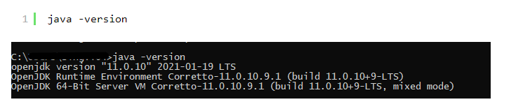
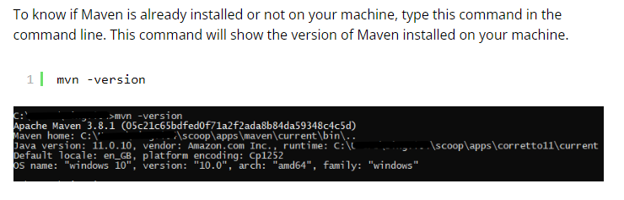
Detailed Step Description
Step 1- Download and Install Java
Java needs to be present on the system to run the tests. Click here to know How to install Java. To know if Java is installed or not on your machine, type this command in the command line. This command will show the version of Java installed on your machine.
Step 2 – Download and setup Eclipse IDE on the system
Step 3 – Setup Maven

Slide 3
Step 4 – Create a new Maven Project
Step 5 – Add REST Assured and TestNG dependencies to the project
Step 6 – Create a TEST file under src/test/java to write the test code.

Slide 4
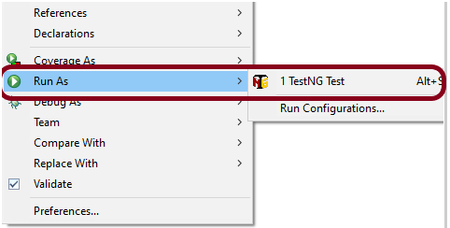
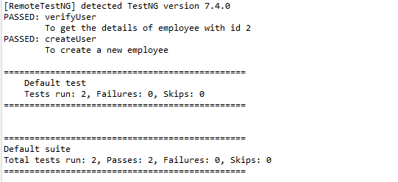
Step 7 – Test Execution through TestNG
This is how the execution console will look like.

Slide 5
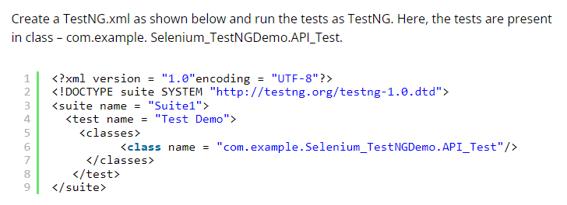
Step 8 – Run the tests from TestNG.xml
Step 9 – TestNG Report Generation
After the test execution, refresh the project, and a new folder with the name test-output will be generated.

Slide 6
